Slide 1
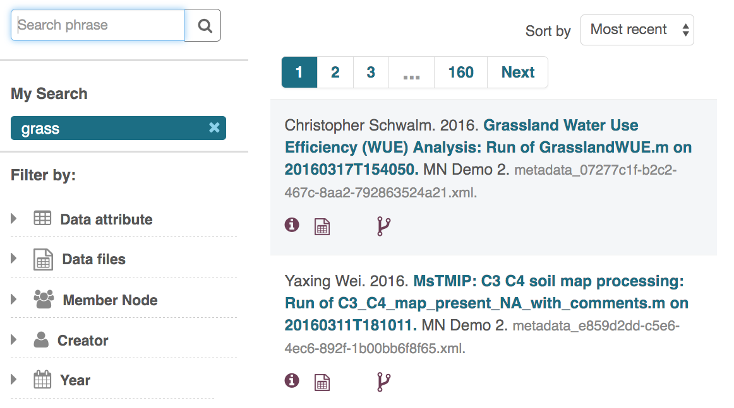
Provenance in action: Benefits & Impact
A DataONE search (here: “grass”) yields different packages with provenance
Notes:
In the DataONE Search, we can search for ‘grass’, and two data packages show up. The Yaxing Wei (Alice) soil map processing workflow and the Christopher Schwalm (Bob) analysis workflows both show that they have provenance information associated with the Data Packages (via the icon in the search record). We next will choose the Wei’s Data Package to see the details. This can be seen at https://search-sandbox-2.test.dataone.org.

Slide 2
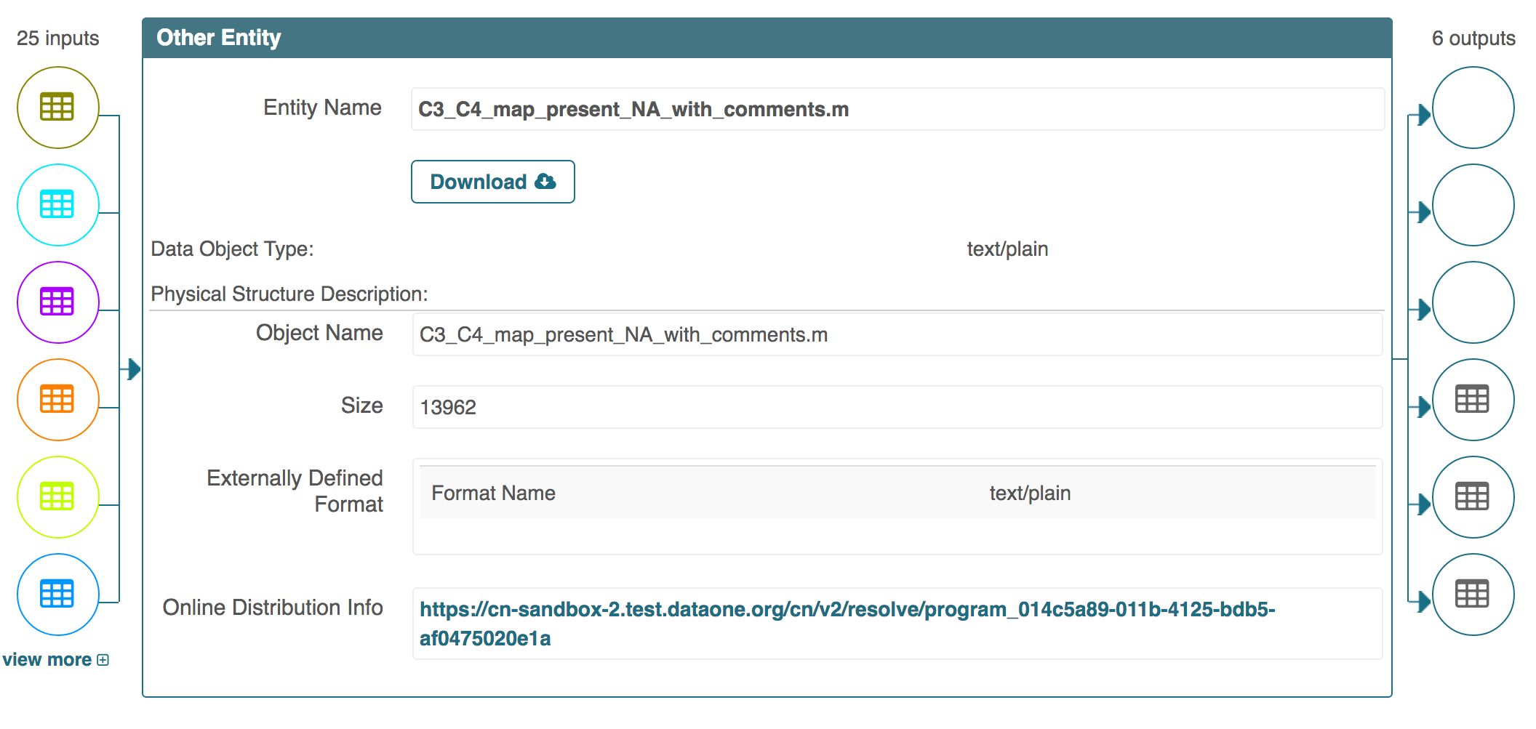
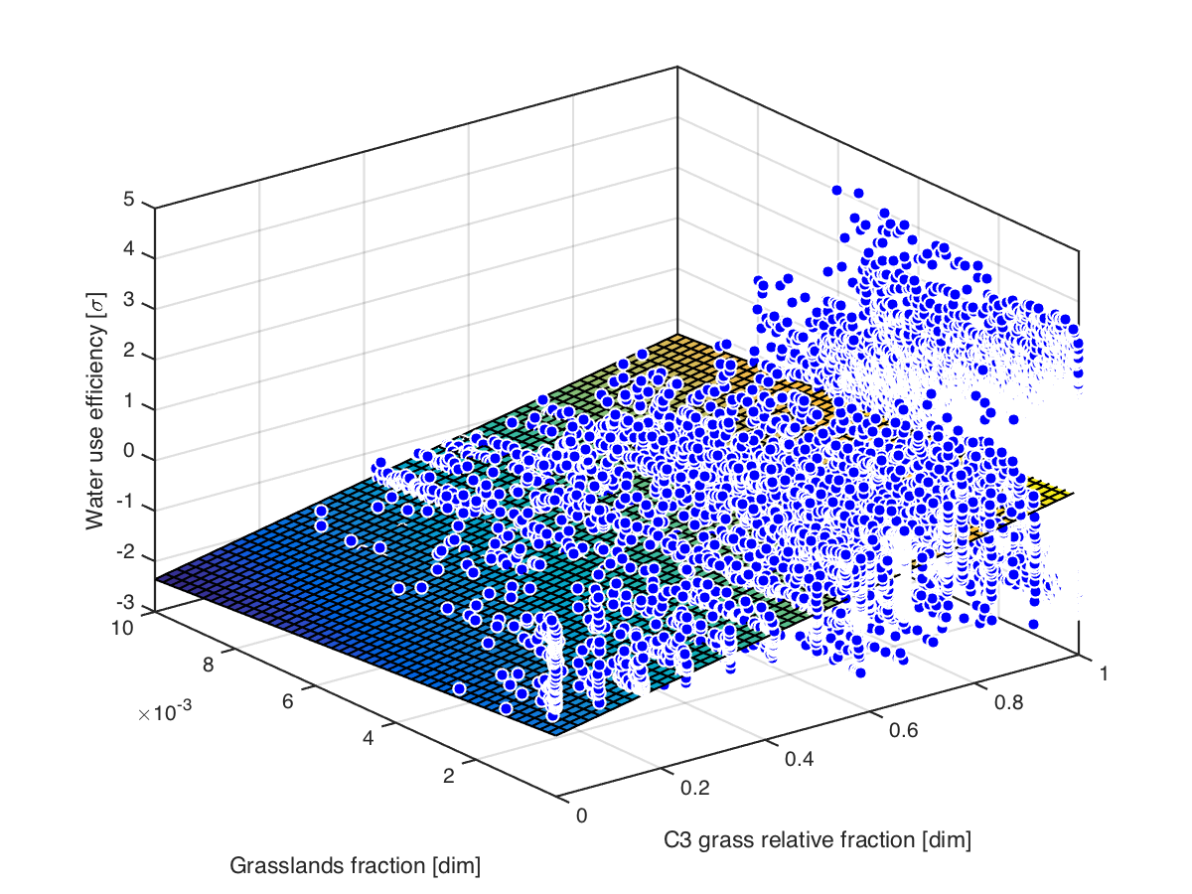
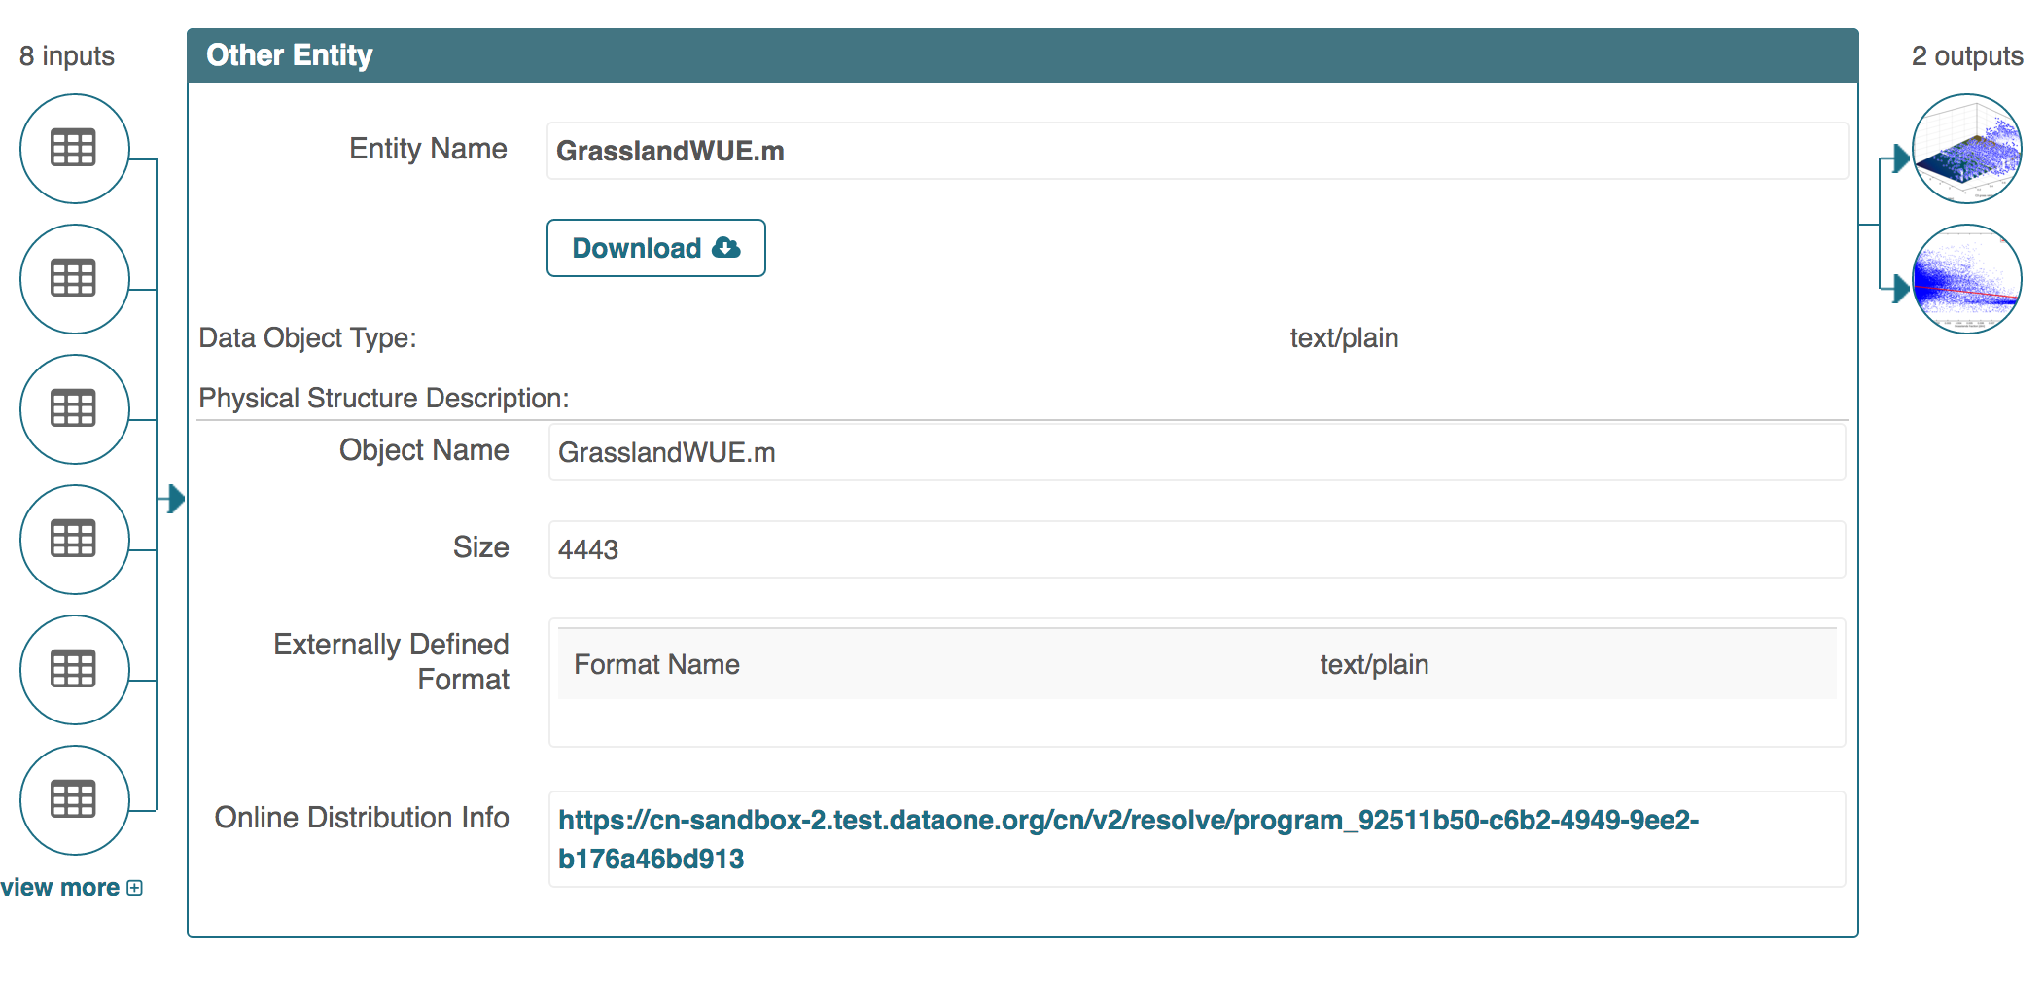
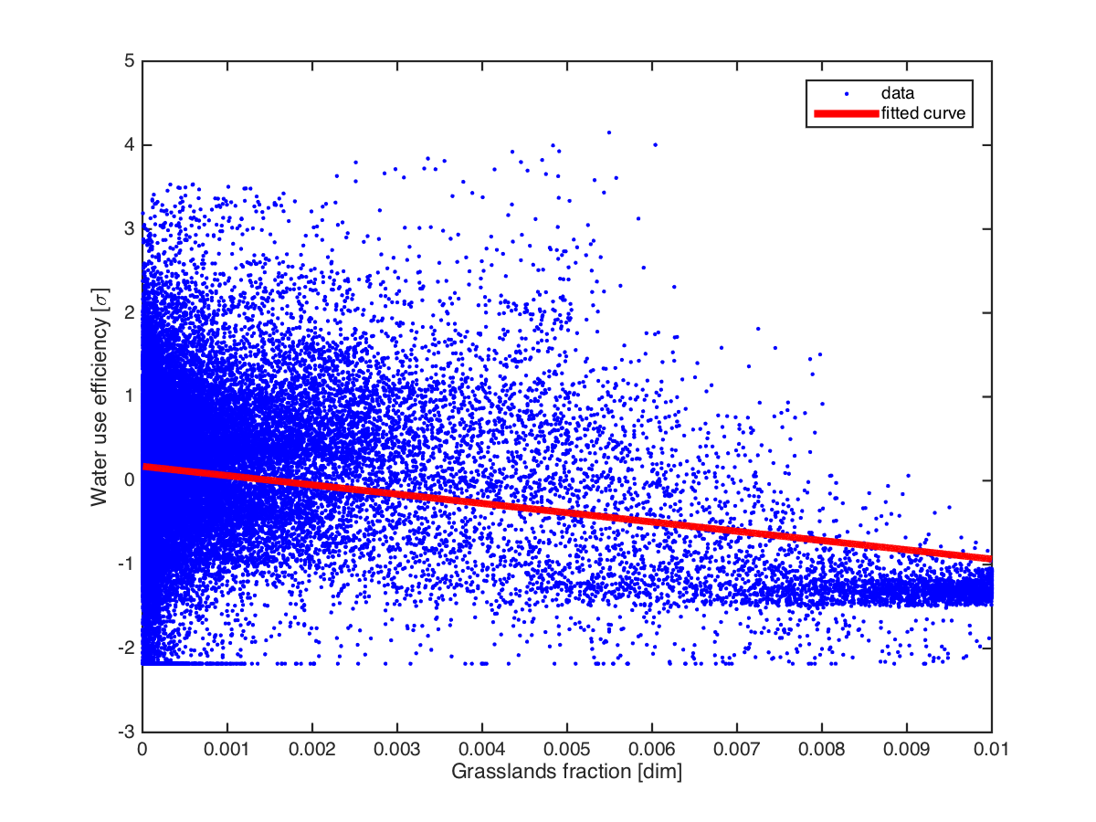
Milestone 3: Provenance
Alice’s script with inputs & output products
YesWorkflow
model
Bob’s results can be traced back all the way to Alice’s input
Bob using Alice’s outputs as inputs for his script
Notes:
Viewing the Wei soil processing workflow we see on the left that the Matlab script (C3_C4_map_present_with_comments.m) has 25 inputs. It also has 6 outputs on the right. The top three outputs are the YesWorkflow diagrams (dataflow, processflow, combined). The bottom three are the NetCDF data files that represent three different world map grids of percentage of grass types (C3 grass fraction, C4 grass fraction, and total grass fraction). The script can be downloaded with the Download button in the center. This can be accessed at https://search-sandbox-2.test.dataone.org/#view/metadata_e859d2dd-c5e6-4ec6-892f-1b00bb6f8f65.xml. Bertram, if you want to show the YesWorkflow diagram (combined) for this run showing how monthly air and precipitation values are used as the inputs, the combined diagram can be accessed from this page, or directly from https://cn-sandbox-2.test.dataone.org/cn/v2/resolve/d87e1a6a-1a78-4f96-bba8-cb74ac2b1efb

Slide 3
Alice’s script with inputs & output products
YesWorkflow
model
Bob’s results can be traced back all the way to Alice’s input
Bob using Alice’s outputs as inputs for his script

